Slide 1
Chapter 3 and 4
Functions!
Graphs!

Slide 2
Random note
The package DSUR from the Field book is not a thing.
That’s ok! We’ll figure it out.

Slide 3
A Suggest-told thing to do
Stack your code.
The code in this section gets quit long.
Stack your code.
You (us) will be able to trouble shoot it easier, it helps see what’s going on, and I am telling you to do it.

Slide 4
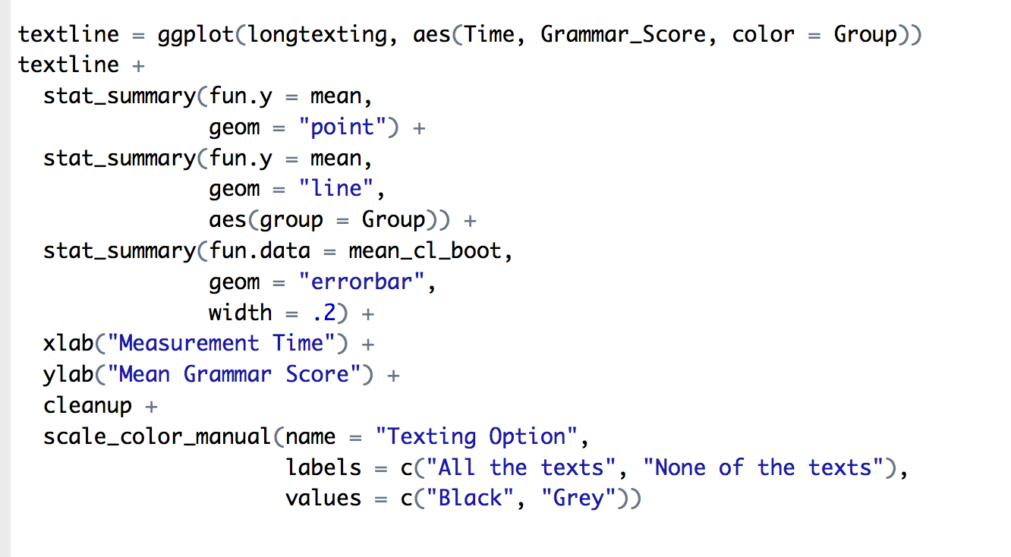

Slide 5
File Functions
We’ve already discussed how to use the import function in Rstudio.
However, that only really works well for csv files. What if we have something else?

Slide 6
File Functions
Install the haven library.
Be sure to load the library!
library(haven)

Slide 7
File Functions
Let’s load SPSS files:
chickdata = read_spss(”dataset.sav")

Slide 8
Factor Functions
Let’s start with some fake data:
notfactor = rep(1:3, 50)
Now, let’s make that data a factor variable.
First, check and see what’s in the data:
table(notfactor)

Slide 9
Factor Functions
factor(column name,
levels = c(1,2…), ##things in the data
labels = c(“labels”, “labels”,…)). ##labels to add
This example:
factored = factor(notfactor,
levels=c(1,2,3),
labels = c("swiss", "feta", "gouda"))
Stack your code!

Slide 10
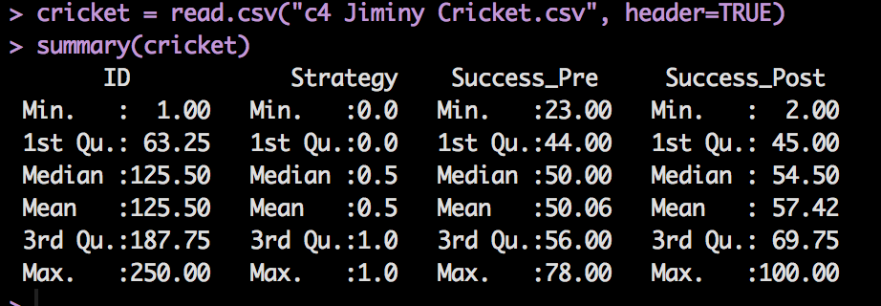
Rearranging your data
Install the reshape package and load the library!
Load the Jiminy Cricket dataset.

Slide 11
Rearranging your data
This data set is considered the WIDE format.
In wide formats, rows are participants and columns are variables.
There’s another way?
In the LONG format, rows are the multiple measurements of the participants.
Wutz?

Slide 12
Rearranging your data
Going from WIDE to LONG
melt() function
Going from LONG to WIDE
cast() function*

Slide 13
Rearranging your data
MELT(
dataframe,
id = c(“column”, “column”) – constant variables you do not want to change
These will stay their own column but get repeated when necessary
measured = c(“column”, “column”) – dependent variables you want to combine into one column
)

Slide 14
Rearranging your data
longcricket = melt(cricket,
id = c("ID", "Strategy"),
measured = c("Success_Pre", "Succcess_Post"))
Let’s look at what that did.

Slide 15
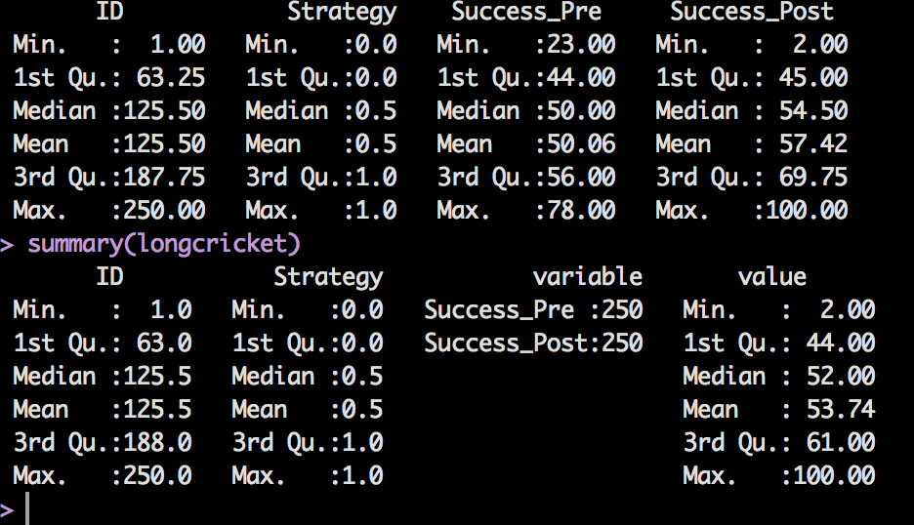
Rearranging your data

Slide 16
Graphs Outline
How to present data clearly
R graphs
Histograms
Boxplots
Error bar charts
Scatterplots
Line Graphs

Slide 17
The Art of Presenting Data
Graphs should (Tufte, 2001):
Show the data.
Induce the reader to think about the data being presented (rather than some other aspect of the graph).
Avoid distorting the data.
Present many numbers with minimum ink.
Make large data sets (assuming you have one) coherent.
Encourage the reader to compare different pieces of data.
Reveal data.

Slide 18
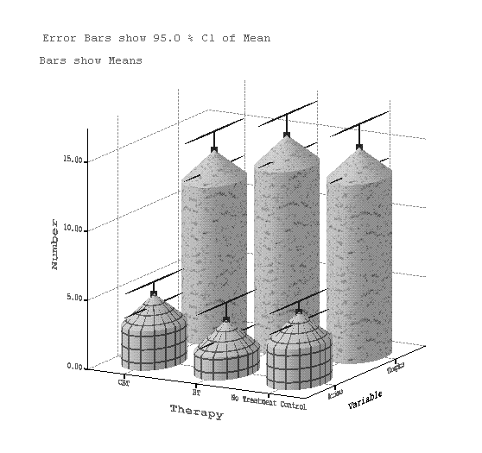
Why is this Graph Bad?

Slide 19
Bad Graphs
3D charts are bad.
Patterns (depending)
Cylindrical bars
Bad axis labels
Overlays

Slide 20
Why is this Graph Better?

Slide 21
Deceiving the Reader

Slide 22
Plots in R
Install ggplot2 package and load the library.
There are lots of plot functions and packages, but ggplot2 is pretty nice.
You may need to install Hmisc (error bars).

Slide 23
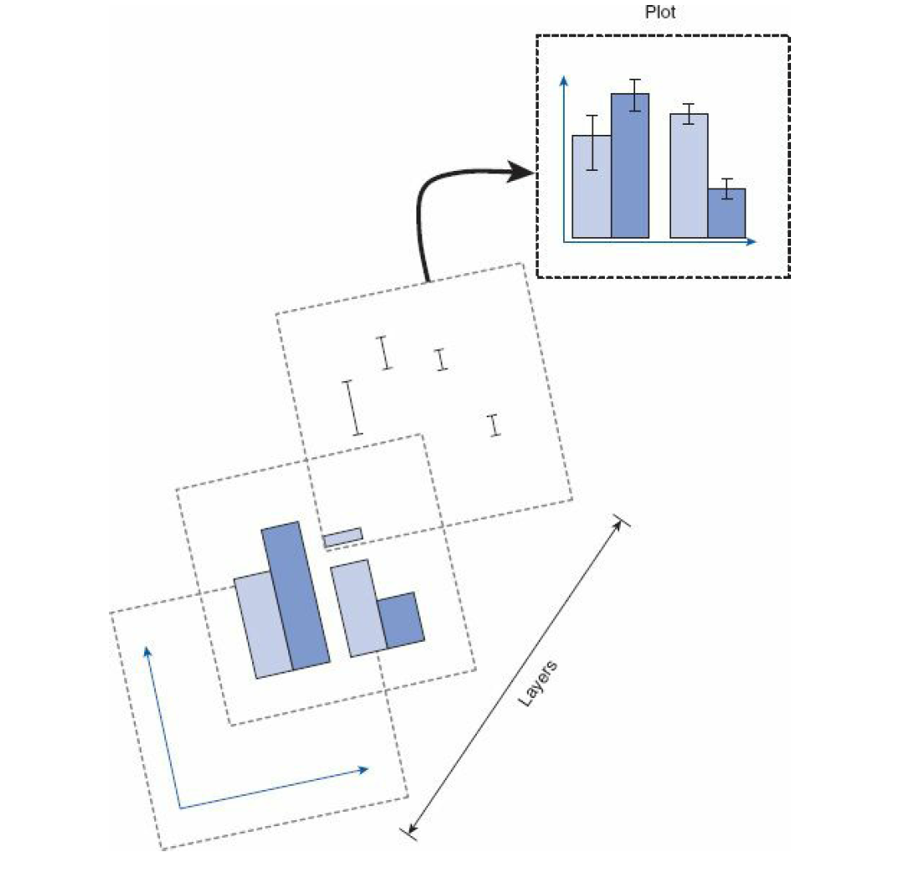

Slide 24
Too many options
Ggplot2 is awesome because it has a zillion options.
But that gets super overwhelming at the beginning.
Remember that section 4.3.2 gives you a handy reference chart.

Slide 25
GGPLOT
How ggplot works:
First you define the basic structure of a plot you want.
Example:
myGraph = ggplot(dataset,
aes(column x axis,
Column y axis,
color/fill = legend column))

Slide 26
GGPLOT
Now we have mygraph saved, but nothing on it really.
So we will add options and layers to create the graph.

Slide 27
GGPLOT
myGraph + OTHER STUFF
myGraph +
geom_bar() +
geom_point() +
xlab(“xlabel”) +
ylab(“ylabel”)
So we are slowing adding components to the graph.

Slide 28
Histograms
Histograms plot:
The continuous score (x-axis)
The frequency (y-axis)
Histograms help us to identify:
The shape of the distribution
Skew
Kurtosis
Spread or variation in scores
Unusual scores

Slide 29
Histograms: Example
I wanted to test the Disney philosophy that ‘Wishing upon a star makes all your dreams come true’.
Measured the success of 250 people using a composite measure involving their salary, quality of life and how close their life matches their aspirations.
Success was measured using a standardised technique :
Score ranged from 0 to 4
0 = Complete failure
4 = Complete success
Participants were randomly allocated to either, Wish upon a star or work as hard as they can for next 5 years.
Success was measured again after 5 years.

Slide 30
Histograms
In ggplot:
Load the Jiminy cricket data and call it cricket.
Histogram – let’s go!
First build the plot:
crickethist = ggplot(cricket, aes(Success_Pre))
(datasetname, aes(column name))

Slide 31
Histograms
But that’s going to be blank, so let’s add a histogram on top of that:
crickethist + geom_histogram()
Make the bins different
crickethist + geom_histogram(binwidth = 0.4)
That color is hideous
crickethist + geom_histogram(binwidth = 0.4, color = “green”)

Slide 32
Histogram of Hygiene Scores for Day 1
Create the plot object:
festivalhist = ggplot(festival, aes(day1))
Add all the plot parts:
geom_histogram(binwidth, color, fill)
xlab()
ylab()
theme_bw() #we will end up doing something better than this clean up

Slide 33
Histograms
Let’s add some labels:
crickethist +
geom_histogram(binwidth = 0.4,
color = "green") +
xlab("Success Pre Test") +
ylab("Frequency")

Slide 34
Histograms: Example
A biologist was worried about the potential health effects of music festivals.
Download Music Festival
Measured the hygiene of 810 concert-goers over the three days of the festival.
Hygiene was measured using a standardized technique :
Score ranged from 0 to 4
0 = you smell like a corpse rotting up a skunk’s arse
4 = you smell of sweet roses on a fresh spring day
DATASET: FESTIVAL DATA

Slide 35
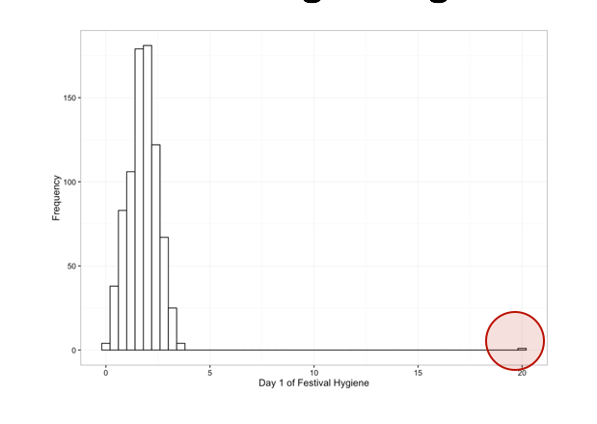
The Resulting Histogram

Slide 36
Rules!
All graphs should have:
X and Y axis labels
NO TITLES (this is APA)
Labels for groups/legend
Error bars when appropriate
And they should be readable and not ugly.

Slide 37
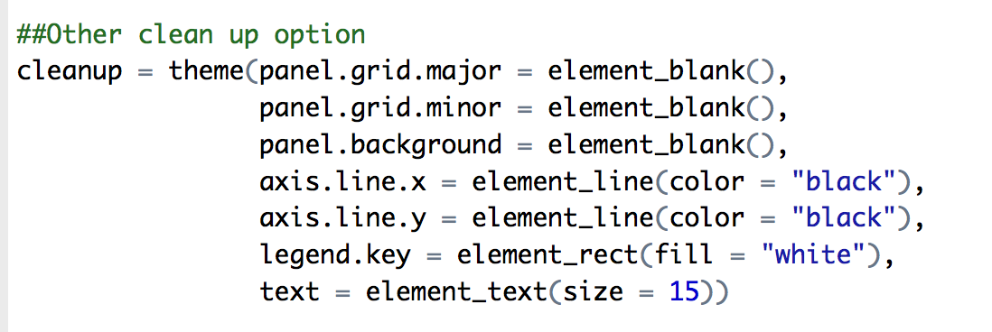
Clean up code
We are going to include some “cleanup” code for each group to help make them presentable.
Save this code and then you can just do graph + cleanup

Slide 38
Scatterplots
Simple scatter – two continuous variables
Grouped scatter – two continuous variables + 1 categorical variable

Slide 39
Scatterplots: Example
Anxiety and exam performance
Participants:
103 students
Measures
Time spent revising (hours)
Exam performance (%)
Exam Anxiety (the EAQ, score out of 100)
Gender
DATASET = EXAM ANXIETY

Slide 40
Scatterplots: Example
First, let’s change gender to a factor – so we can use it later for graphing appropriately.
exam$Gender = factor(exam$Gender,
levels=c(1,2),
labels = c("Male", "Female"))

Slide 41
Simple Scatterplot
scatter = ggplot(exam, aes(Anxiety, Exam))
scatter +
geom_point() +
xlab("Success Pre Test") +
ylab("Frequency") +
cleanup

Slide 42
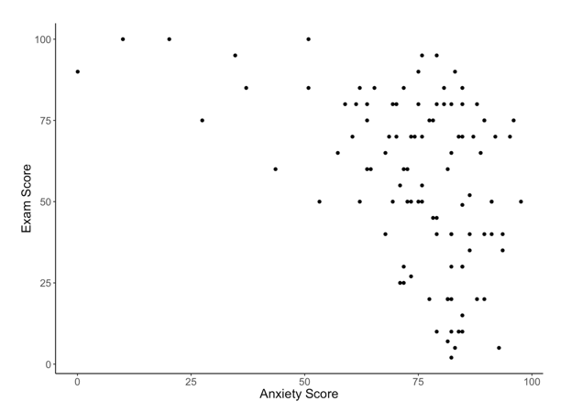
Simple Scatterplot
Scatterplot of exam anxiety against exam performance

Slide 43
Simple Scatterplot With Regression Line
scatter = ggplot(exam, aes(Anxiety, Exam))
scatter +
geom_point() +
geom_smooth(method = "lm", color = ”black") +
xlab("Anxiety Level") +
ylab("Exam Performance") +
cleanup

Slide 44
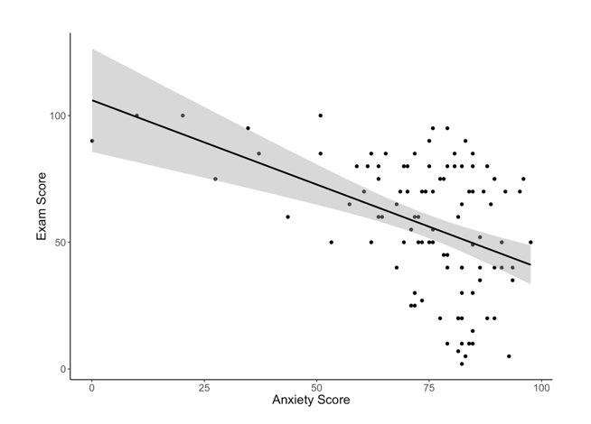
Simple Scatterplot
A simple scatterplot with a regression line added

Slide 45
Grouped Scatterplot
scatter = ggplot(examData,
aes(Anxiety, Exam, color = Gender, fill = Gender))
scatter +
geom_point() +
geom_smooth(method = "lm") +
xlab("Anxiety Level") +
ylab("Exam Performance") +
cleanup

Slide 46
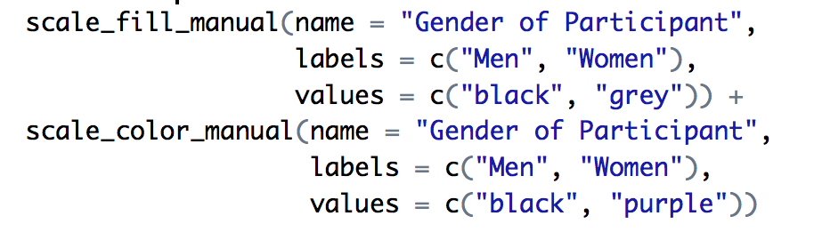
Grouped Scatterplot
How to control the colors and fill with legends.
scale_fill_manual(name, labels, values)
scale_color_manual(name, labels, values)
Why both?

Slide 47
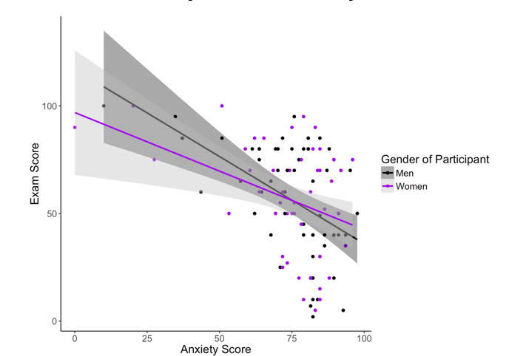
Grouped Scatterplot
Scatterplot of exam anxiety and exam performance split by gender

Slide 48
Bar Charts + Error
The bar (usually) shows the mean score
The error bar displays the precision of the mean in one of three ways:
The confidence interval (usually 95%)
The standard deviation
The standard error of the mean

Slide 49
Bar Chart: One Independent Variable
Is there such a thing as a ‘chick flick’?
Participants:
20 men
20 women
Half of each sample saw one of two films:
A ‘chick flick’ (Bridget Jones’s Diary),
Control (Memento).
Outcome measure
Physiological arousal as an indicator of how much they enjoyed the film.
DATASET = CHICK FLICK

Slide 50
Bar Chart Note
To get bar charts to work appropriately, make sure your categorical IVs are factor variables
Else you will get very strange errors in ggplot.

Slide 51
Bar Chart: One Independent Variable
To plot the mean arousal score (y-axis) for each film (x-axis) first create the plot object:
chickbar = ggplot(chick, aes(film, arousal))

Slide 52
Bar Chart: One Independent Variable
To add the mean, displayed as bars, we can add this as a layer to bar using the stat_summary() function:
chickbar +
stat_summary(fun.y = mean,
geom = "bar",
fill = "White",
color = "Black")

Slide 53
Bar Chart: One Independent Variable
To add error bars, add these as a layer using stat_summary():
+ stat_summary(fun.data = mean_cl_normal,
geom = "errorbar",
position = position_dodge(width = 0.90),
width = 0.2)

Slide 54
Bar Chart: One Independent Variable
Now, add the rest of things we’ve been doing
xlab(“label”) +
ylab(“label”) +
cleanup +
scale_x_discrete(labels = c("Girl Film", "Guy Film"))
**scale_x_discrete allows us to change the labels/names for the x axis but NOT color (that’s scale_x_manual)

Slide 55
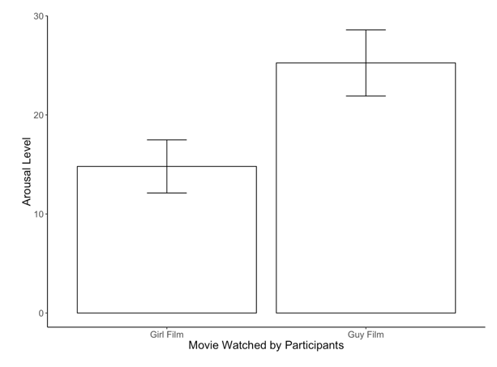
Bar Chart: One Independent Variable

Slide 56
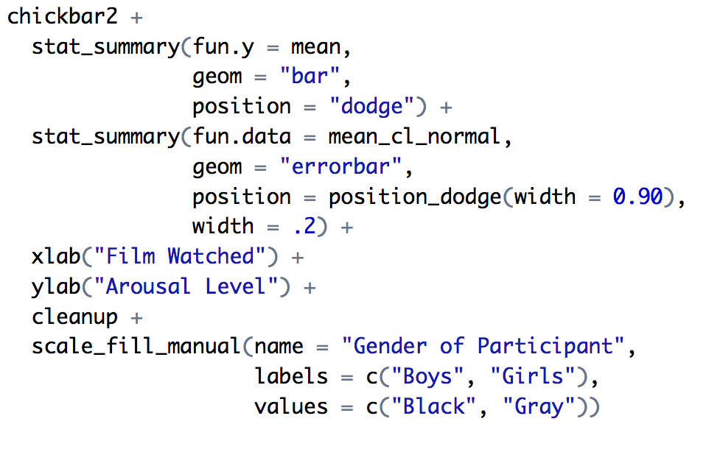
Bar Chart: Two Independent Variables
Chickbar2 = ggplot(chick, aes(film, arousal, fill = gender))
So why no color?

Slide 57
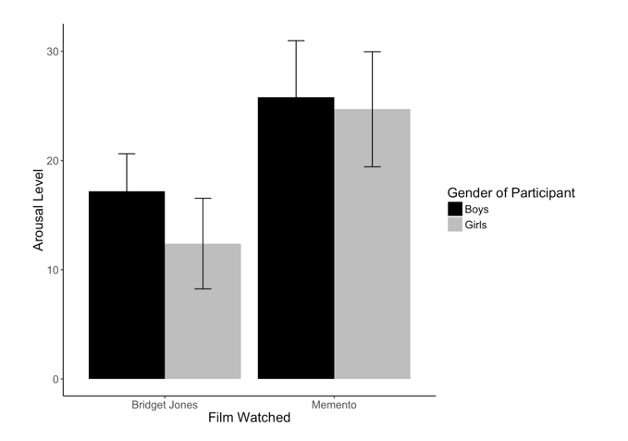
Bar Chart: Two Independent Variables

Slide 58
Line Graphs
When to use a line graph:
With data that X is categorical, but is considered “mildly continuous”
Usually with repeated measures data over time.
(which is not what these examples are but oh well).

Slide 59
Line Graphs: One Independent Variable
How to cure hiccups?
Participants:
15 hiccup sufferers
Each tries four interventions (in random order):
Baseline
Tongue-pulling manoeuvres
Massage of the carotid artery
Other
Outcome measure
The number of hiccups in the minute after each procedure
DATASET: HICCUP DATA

Slide 60
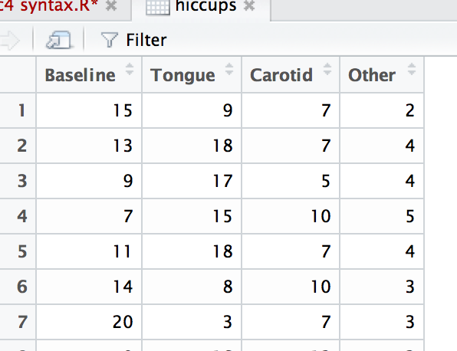

Slide 61
Line Graphs: One Independent Variable
These data are in the wrong format for ggplot2 to use.
We need all of the scores stacked up in a single column and then another variable that specifies the type of intervention.
Melt time!

Slide 62
Melt the data
longhiccups = melt(hiccups,
measured = c("Baseline", "Tongue", "Carotid", "Other"))
Notice there’s no ID, that’s ok.

Slide 63
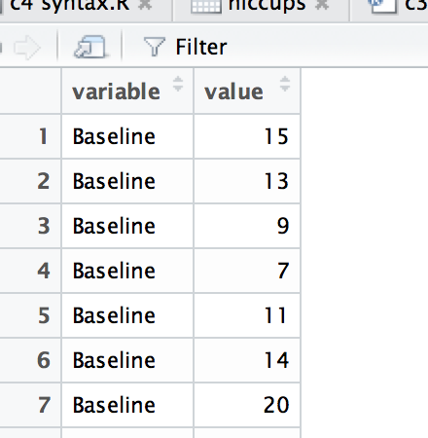

Slide 64
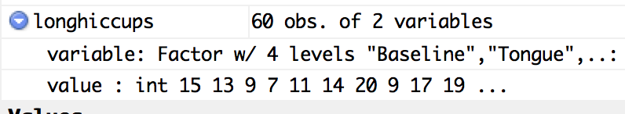
Line Graphs: One Independent Variable
Then you need to make sure your new variable is a factor.
It is yay!
But always check.

Slide 65
Line Graphs: One Independent Variable
We can then create the line graph:
hiccupline = ggplot(longhiccups, aes(variable, value))
Notice they are called variable and value.
We can change that to make more sense.
colnames(longhiccups) = c("Intervention", "Hiccups")
hiccupline = ggplot(longhiccups, aes(Intervention, Hiccups))

Slide 66
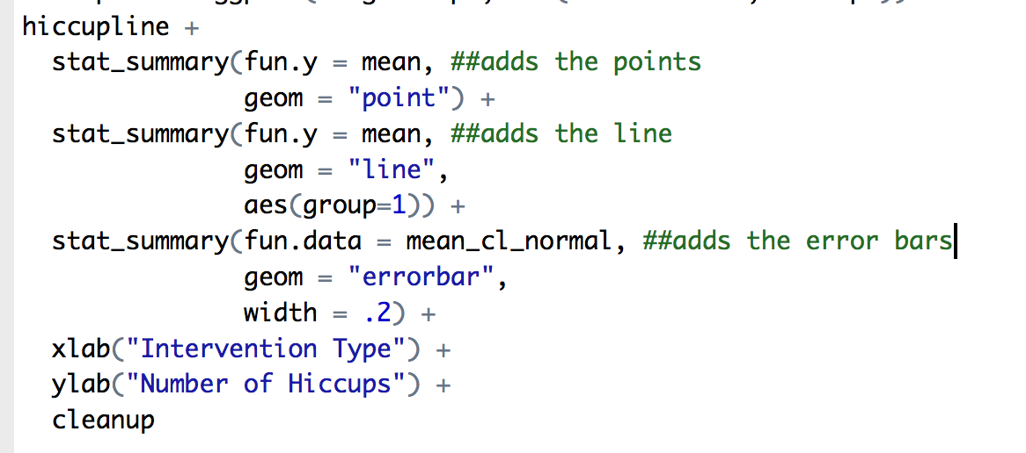
Line Graphs: One Independent Variable
Add the rest of the formatting:

Slide 67
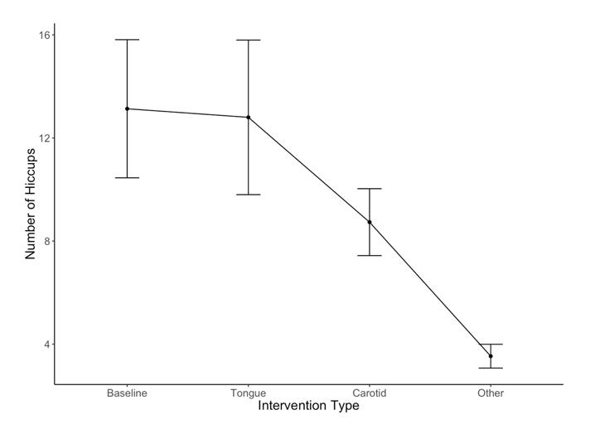
Line chart with error bars of the mean number of hiccups at baseline and after various interventions

Slide 68
Line Graphs for Several Independent Variables
Is text-messaging bad for your grammar?
Participants:
50 children
Children split into two groups:
Text-messaging allowed
Text-messaging forbidden
Each child measures at two points in time:
Baseline
6 months later
Outcome measure
Percentage score on a grammar test
DATASET: TEXTING

Slide 69
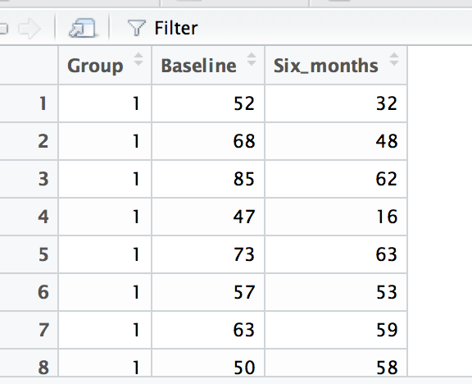
First, let’s fix the group problem:
texting$Group = factor(texting$Group,
levels=c(1,2),
labels=c("Texting Allowed", "Texting Forbidden"))

Slide 70
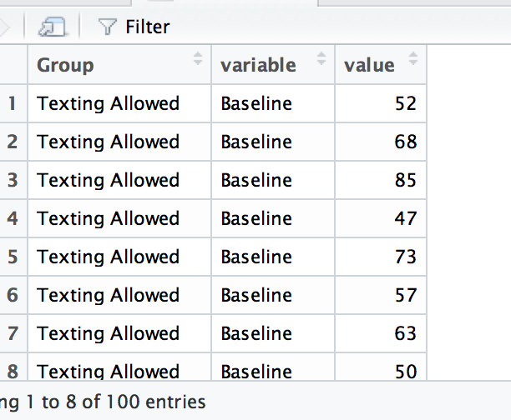
Melt the data!

Slide 71
Fix the column names
colnames(textMessages) =
c( “Group”, “Time”, "Grammar_Score”)

Slide 72
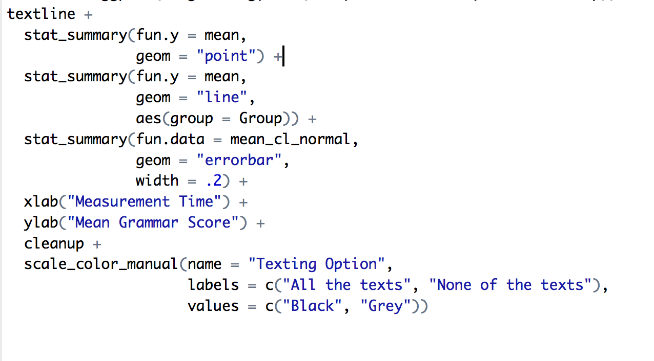
Line Graphs for Several Independent Variables
textline = ggplot(longtexting, aes(Time, Grammar_Score, color = Group))

Slide 73
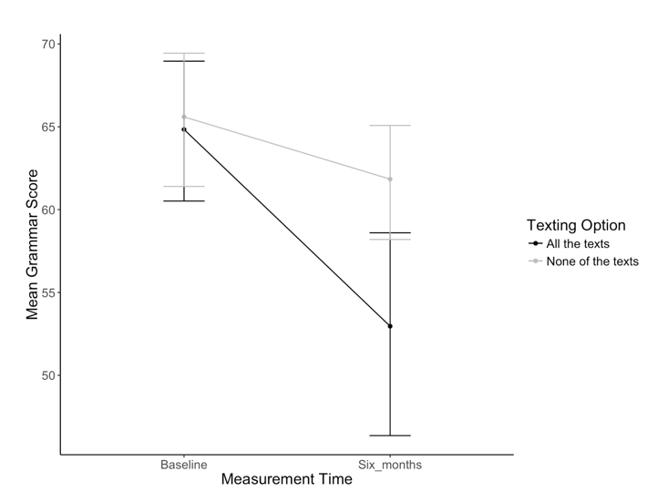
Error line graph of the mean grammar score over six months in children who were allowed to text-message versus those who were forbidden

